Slide 1
Chapter 11
Multi-Way Search Trees

Slide 2
Introduction
In such a tree M is called the degree of the tree. Note in a binary search tree M = 2, so it has one value and 2 sub-trees. In other words, every internal node of an M-way search tree consists of pointers to M sub-trees and contains M – 1 keys, where M > 2.
P₀ | K₀ | P₁ | K₁ | P₂ | K₂ | ……… | P_{n-1} | K_{n-1} | P_{n}
In the structure, P0, P1, P2,…, Pn are pointers to the node’s sub-trees and K0, K1, K2,…, Kn-1 are the key values of the node. All the key values are stored in ascending order. That is, Ki < Ki+1 for 0 ≤ i ≤ n-2.
In an M-way search tree, it is not compulsory that every node has exactly (M-1) values and have exactly M sub-trees. Rather, the node can have anywhere from 1 to (M-1) values, and the number of sub-trees may vary from 0 (for a leaf node) to 1 + i, where i is the number of key values in the node. M is thus a fixed upper limit that defines how much key values can be stored in the node.

Slide 3
Introduction
 | 18 |  | 45
 | 9 |  | 11
 | 27 |  | 36
 | 54 |  | 63
 | 29 |  | 30
 | 72 |  | 81
In the structure, P0, P1, P2,…, Pn are pointers to the node’s sub-trees and K0, K1, K2,…, Kn-1 are the key values of the node. All the key values are stored in ascending order. That is, Ki < Ki+1 for 0 ≤ i ≤ n-2.
In an M-way search tree, it is not compulsory that every node has exactly (M-1) values and have exactly M sub-trees. Rather, the node can have anywhere from 1 to (M-1) values, and the number of sub-trees may vary from 0 (for a leaf node) to 1 + i, where i is the number of key values in the node. M is thus a fixed upper limit that defines how much key values can be stored in the node.

Slide 4
B-Trees
A B-tree is a specialized m- way tree that is widely used for disk access. A B tree of order m can have maximum m-1 keys and m pointers to its sub-trees. A B-tree may contain a large number of key values and pointers to sub-trees. Storing a large number of keys in a single node keeps the height of the tree relatively small.
A B-tree is designed to store sorted data and allows search, insert, and delete operations to be performed in logarithmic amortized time. A B-tree of order m (the maximum number of children that each node can have) is a tree with all the properties of an m-way search tree and in addition has the following properties:
Every node in the B-tree has at most (maximum) m children.

Slide 5
B-Trees
Every node in the B-tree except the root node and leaf nodes have at least (minimum) m⁄2 children. This condition helps to keep the tree bushy so that the path from the root node to the leaf is very short even in a tree that stores a lot of data.
The root node has at least two children if it is not a terminal (leaf) node.
All leaf nodes are at the same level.
An internal node in the B tree can have n number of children, where 0 ≤n ≤ m. it is not necessary that every node has the same number of children, but the only restriction is that the node should have at least m/2 children.

Slide 6
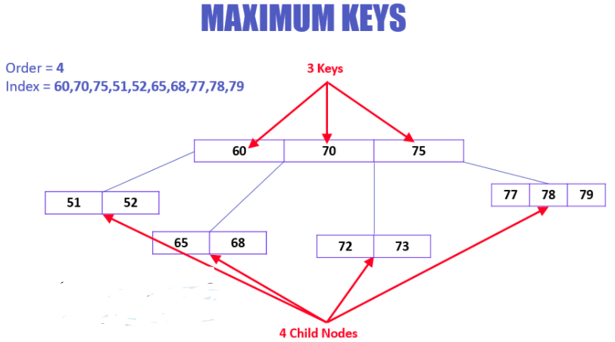

Slide 7
B-Trees
O | 45 | O
O | 29 | O | 32 | O
O | 49 | O | 63 | O
O | 54 | O | 59 | O | 61 | O
O | 30 | O | 31 | O
O | 67 | O | 72 | O
O | 36 | O | 39 | O
O | 46 | O | 47 | O
O | 18 | O | 27 | O

Slide 8
Here, are important rules for creating B_Tree
All leaves will be created at the same level.
B-Tree is determined by a number of degree, which is also called “order” (specified by an external actor, like a programmer), referred to as m.
The left subtree of the node will have lesser values than the right side of the subtree. This means that the nodes are also sorted in ascending order from left to right.
The maximum number of child nodes, a root node as well as its child nodes can contain are calculated by this formula: m
For e.g. m = 4, max keys = 4-1=3

Slide 9
Important Points
Property #1 - All leaf nodes must be at same level.
Property #2 - All nodes except root must have at least [m/2]-1 keys and maximum of m-1 keys.
Property #3 - All non leaf nodes except root (i.e. all internal nodes) must have at least m/2 children.
Property #4 - If the root node is a non leaf node, then it must have atleast 2 children.
Property #5 - A non leaf node with n-1 keys must have n number of children.
Property #6 - All the key values in a node must be in Ascending Order.
For example, B-Tree of Order 4 contains a maximum of 3 key values in a node and maximum of 4 children for a node.

Slide 10

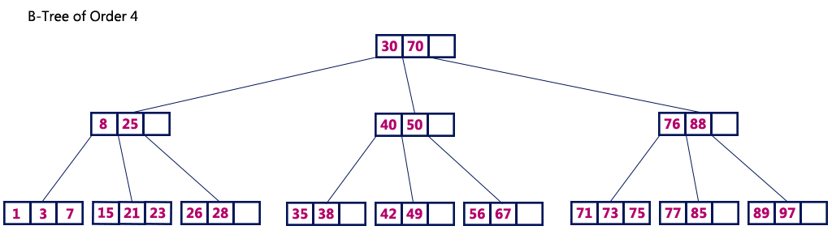

Slide 11
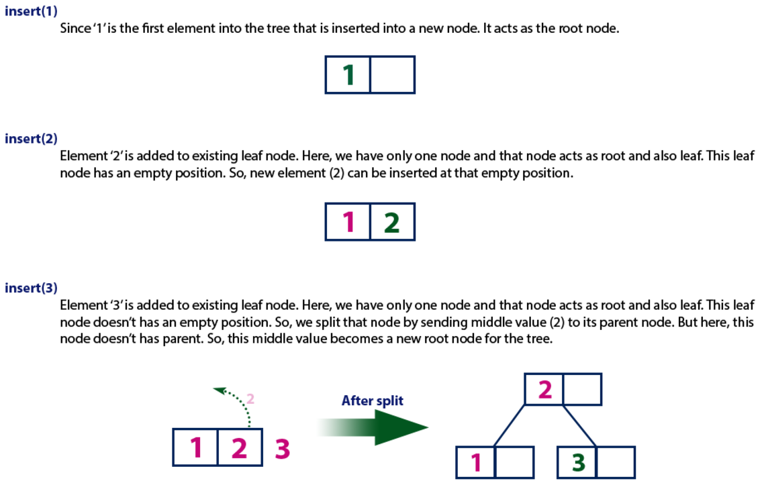
Construct a B-Tree of Order 3 by inserting numbers from 1 to 10.

Slide 12
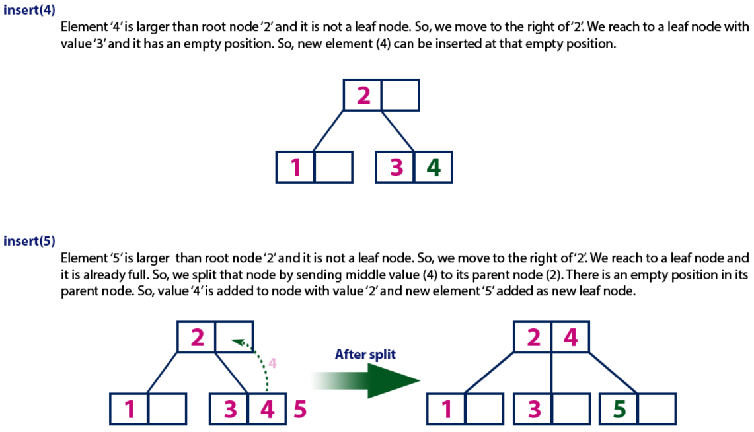

Slide 13
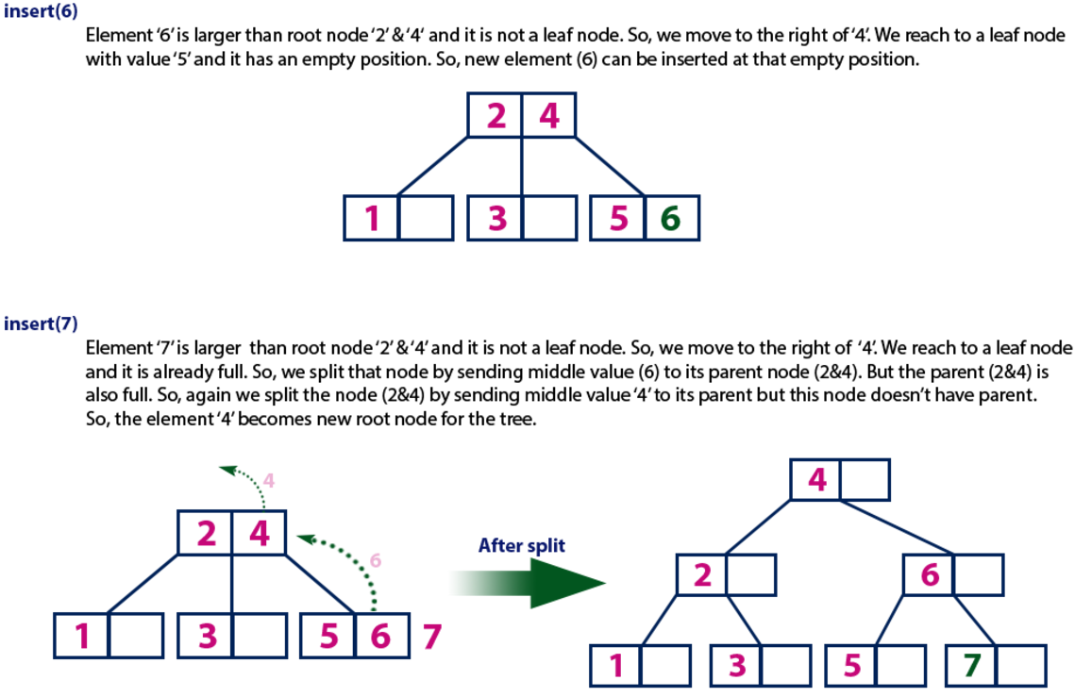

Slide 14
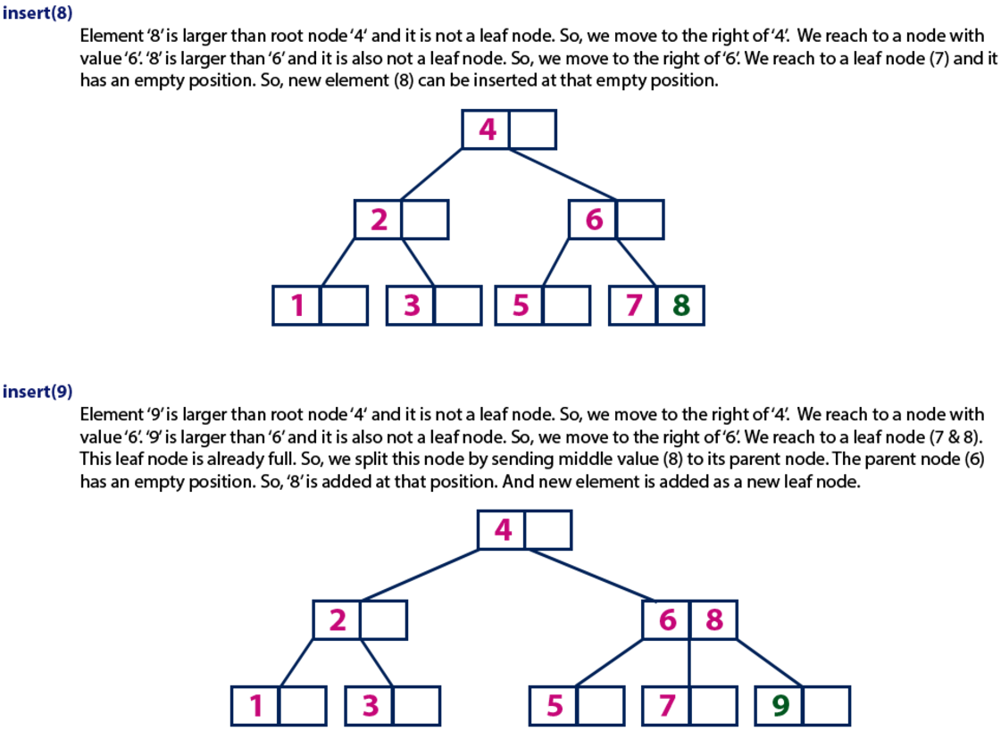

Slide 15
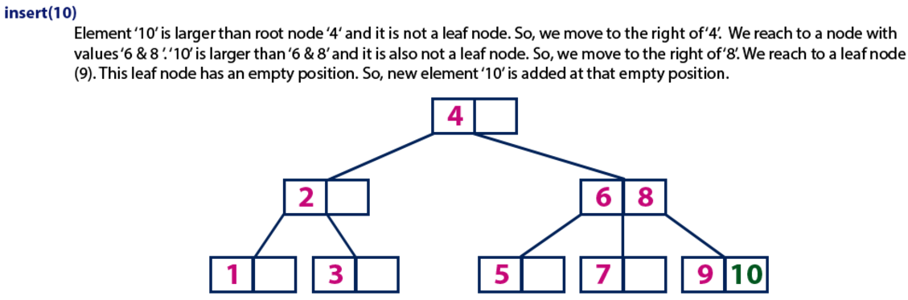

Slide 16
Every node, except root, must contain minimum keys of [m/2] – 1, e.g. m=4, minimum keys = 2
The maximum number of child nodes a node can have is equal to its degree, which is m
The minimum children a node can have is half of the order, which is m/2 (the ceiling value is taken).
All the keys in a node are sorted in increasing order.
  E.g. m(order)=5
  Min children = m/2 = 3(ceiling value)
  Max children = 5
  Min key = (m/2)-1 = 2
  Max key = 4

Slide 17
B-Trees
Insert Operation
In a B tree all insertions are done at the leaf node level. A new value is inserted in the B tree using the algorithm given below.
Search the B tree to find the leaf node where the new key value should be inserted.
If the leaf node is not full, that is it contains less than m-1 key values then insert the new element in the node, keeping the node's elements ordered.
If the leaf node is full, that is the leaf node already contain m-1 key values then
  insert the new value in order into the existing set of keys split the node at its median into two nodes. note that the split nodes are half full. Push the median element up to its parent’s node. If the parent’s node is already full, then split the parent node by following the same steps.

Slide 18
B-Trees
Example: Look at the B tree of order 5 given below and insert 8, 9, 39 into it.
O | 18 | O | 45 | O | 72 | O
O | 7 | O | 11 | O
O | 54 | O | 63 | O
O | 21 | O | 27 | O | 36 | O | 42 | O
O | 81 | O | 89 | O | 90 | O
O | 18 | O | 45 | O | 72 | O
O | 7 | O | 8 | O | 11 | O
O | 21 | O | 27 | O | 36 | O | 42 | O
O | 54 | O | 63 | O
O | 81 | O | 89 | O | 90 | O
O | 18 | O | 45 | O | 72 | O
O | 81 | O | 89 | O | 90 | O
O | 7 | O | 8 | O | 9 | O | 11 | O
O | 21 | O | 27 | O | 36 | O | 42 | O
O | 54 | O | 63 | O
O | 18 | O | 36 | O | 45 | O | 72 | O
O | 81 | O | 89 | O | 90 | O
O | 7 | O | 8 | O | 9 | O | 11 | O
O | 21 | O | 27 | O
O | 39 | O | 42 | O
O | 54 | O | 63 | O

Slide 19
Deletion
Like insertion, deletion is also done from the leaf nodes. There are two cases of deletion. First, a leaf node has to be deleted. Second, an internal node has to be deleted. Let us first see the steps involved in deleting a leaf node.
Locate the leaf node which has to be deleted
If the leaf node contains more than minimum number of key values (more than m/2 elements), then delete the value.
Else, if the leaf node does not contain even m/2 elements then, fill the node by taking an element either from the left or from the right sibling
  If the left sibling has more than the minimum number of key values (elements), push its largest key into its parent’s node and pull down the intervening element from the parent node to the leaf node where the key is deleted. Else if the right sibling has more than the minimum number of key values (elements), push its smallest key into its parent node and pull down the intervening element from the parent node to the leaf node where the key is deleted.

Slide 20
Deletion
Else, if both left and right siblings contain only minimum number of elements, then create a new leaf node by combining the two leaf nodes and the intervening element of the parent node (ensuring that the number of elements do not exceed the maximum number of elements a node can have, that is, m). If pulling the intervening element from the parent node leaves it with less than minimum number of keys in the node, then propagate the process upwards thereby reducing the height of the B tree.
To delete an internal node, promote the successor or predecessor of the key to be deleted to occupy the position of the deleted key. This predecessor or successor will always be in the leaf node. So further the processing will be done as if a value from the leaf node has been deleted.

Slide 21
Deletion
Consider the B tree of order 5 given below and delete the values- 93, 201 from it.
O | 108 | O
O | 117 | O | 201 | O
O | 63 | O | 81 | O
O | 151 | O | 180 | O
O | 36 | O | 45 | O
O | 90 | O | 93 | O | 101 | O
O | 243 | O | 256 | O | 333 | O | 450 | O
O | 72 | O | 79 | O
O | 111 | O | 114 | O
O | 108 | O
O | 117 | O | 243 | O
O | 63 | O | 81 | O
O | 151 | O | 180 | O
O | 36 | O | 45 | O
O | 90 | O | 101 | O
O | 256 | O | 333 | O | 450 | O
O | 111 | O | 114 | O
O | 72 | O | 79 | O

Slide 22
B+ Trees
A B+ tree is a variant of a B tree which stores sorted data in a way that allows for efficient insertion, retrieval and removal of records, each of which is identified by a key. While a B tree can store both keys and records in its interior nodes, a B+ tree, in contrast, stores all records at the leaf level of the tree; only keys are stored in interior nodes.
The leaf nodes of the B+ tree are often linked to one another in a linked list. This has an added advantage of making the queries simpler and more efficient.
Typically B+-trees are used to store large amounts of data that cannot be stored in the main memory. With B+ trees, the secondary storage (magnetic disk) is used to store the leaf nodes of the tree and the internal nodes of the tree are stored in the main memory.
B+-tree stores data only in the leaf nodes. All other nodes (internal nodes) are called index nodes or i-nodes and store index values which allow us to traverse the tree from the root down to the leaf node that stores the desired data item.

Slide 23
B+ Trees
O | 13 | O
O | 4 | O | 7 | O
O | 17 | O | 20 | O
O | 23 | O | 24 | O
O | 8 | O | 11 | O
O | 1 | O | 3 | O
O | 14 | O | 16 | O
O | 5 | O | 6 | O
O | 18 | O | 19 | O

Slide 24
Trie
The term trie has been taken from the word "retrieval". A trie is an ordered tree data structure introduced in the 1960's by Fredkin.
Trie stores keys that are usually strings. It is basically a k-ary position tree.
In contrast to the binary search trees, node in the trie does not store the key associated with that node. Rather, its position in the tree represents the key associated with that node. All the descendants of a node have a common prefix of the string associated with that node, and the root is associated with the empty string.

Slide 25
Trie
a
d
m
a
I
d
r
I
5
o
am
do
8
3
c
ar
t
arc
m
art
15
e
arm
12
dot
11
are
9
A trie is very commonly used to store a dictionary (for ex, on a mobile telephone). These applications take advantage of a trie’s ability to quickly search, insert, and delete entries. Tries are also used to implement approximate matching algorithms, including those used in spell checking software.

Slide 26

B Tree
Create a B Tree of order 3 by using values from 1 to 10.
As m = 3 i.e. child nodes = m =3, keys = values = m-1 = 2

Slide 27
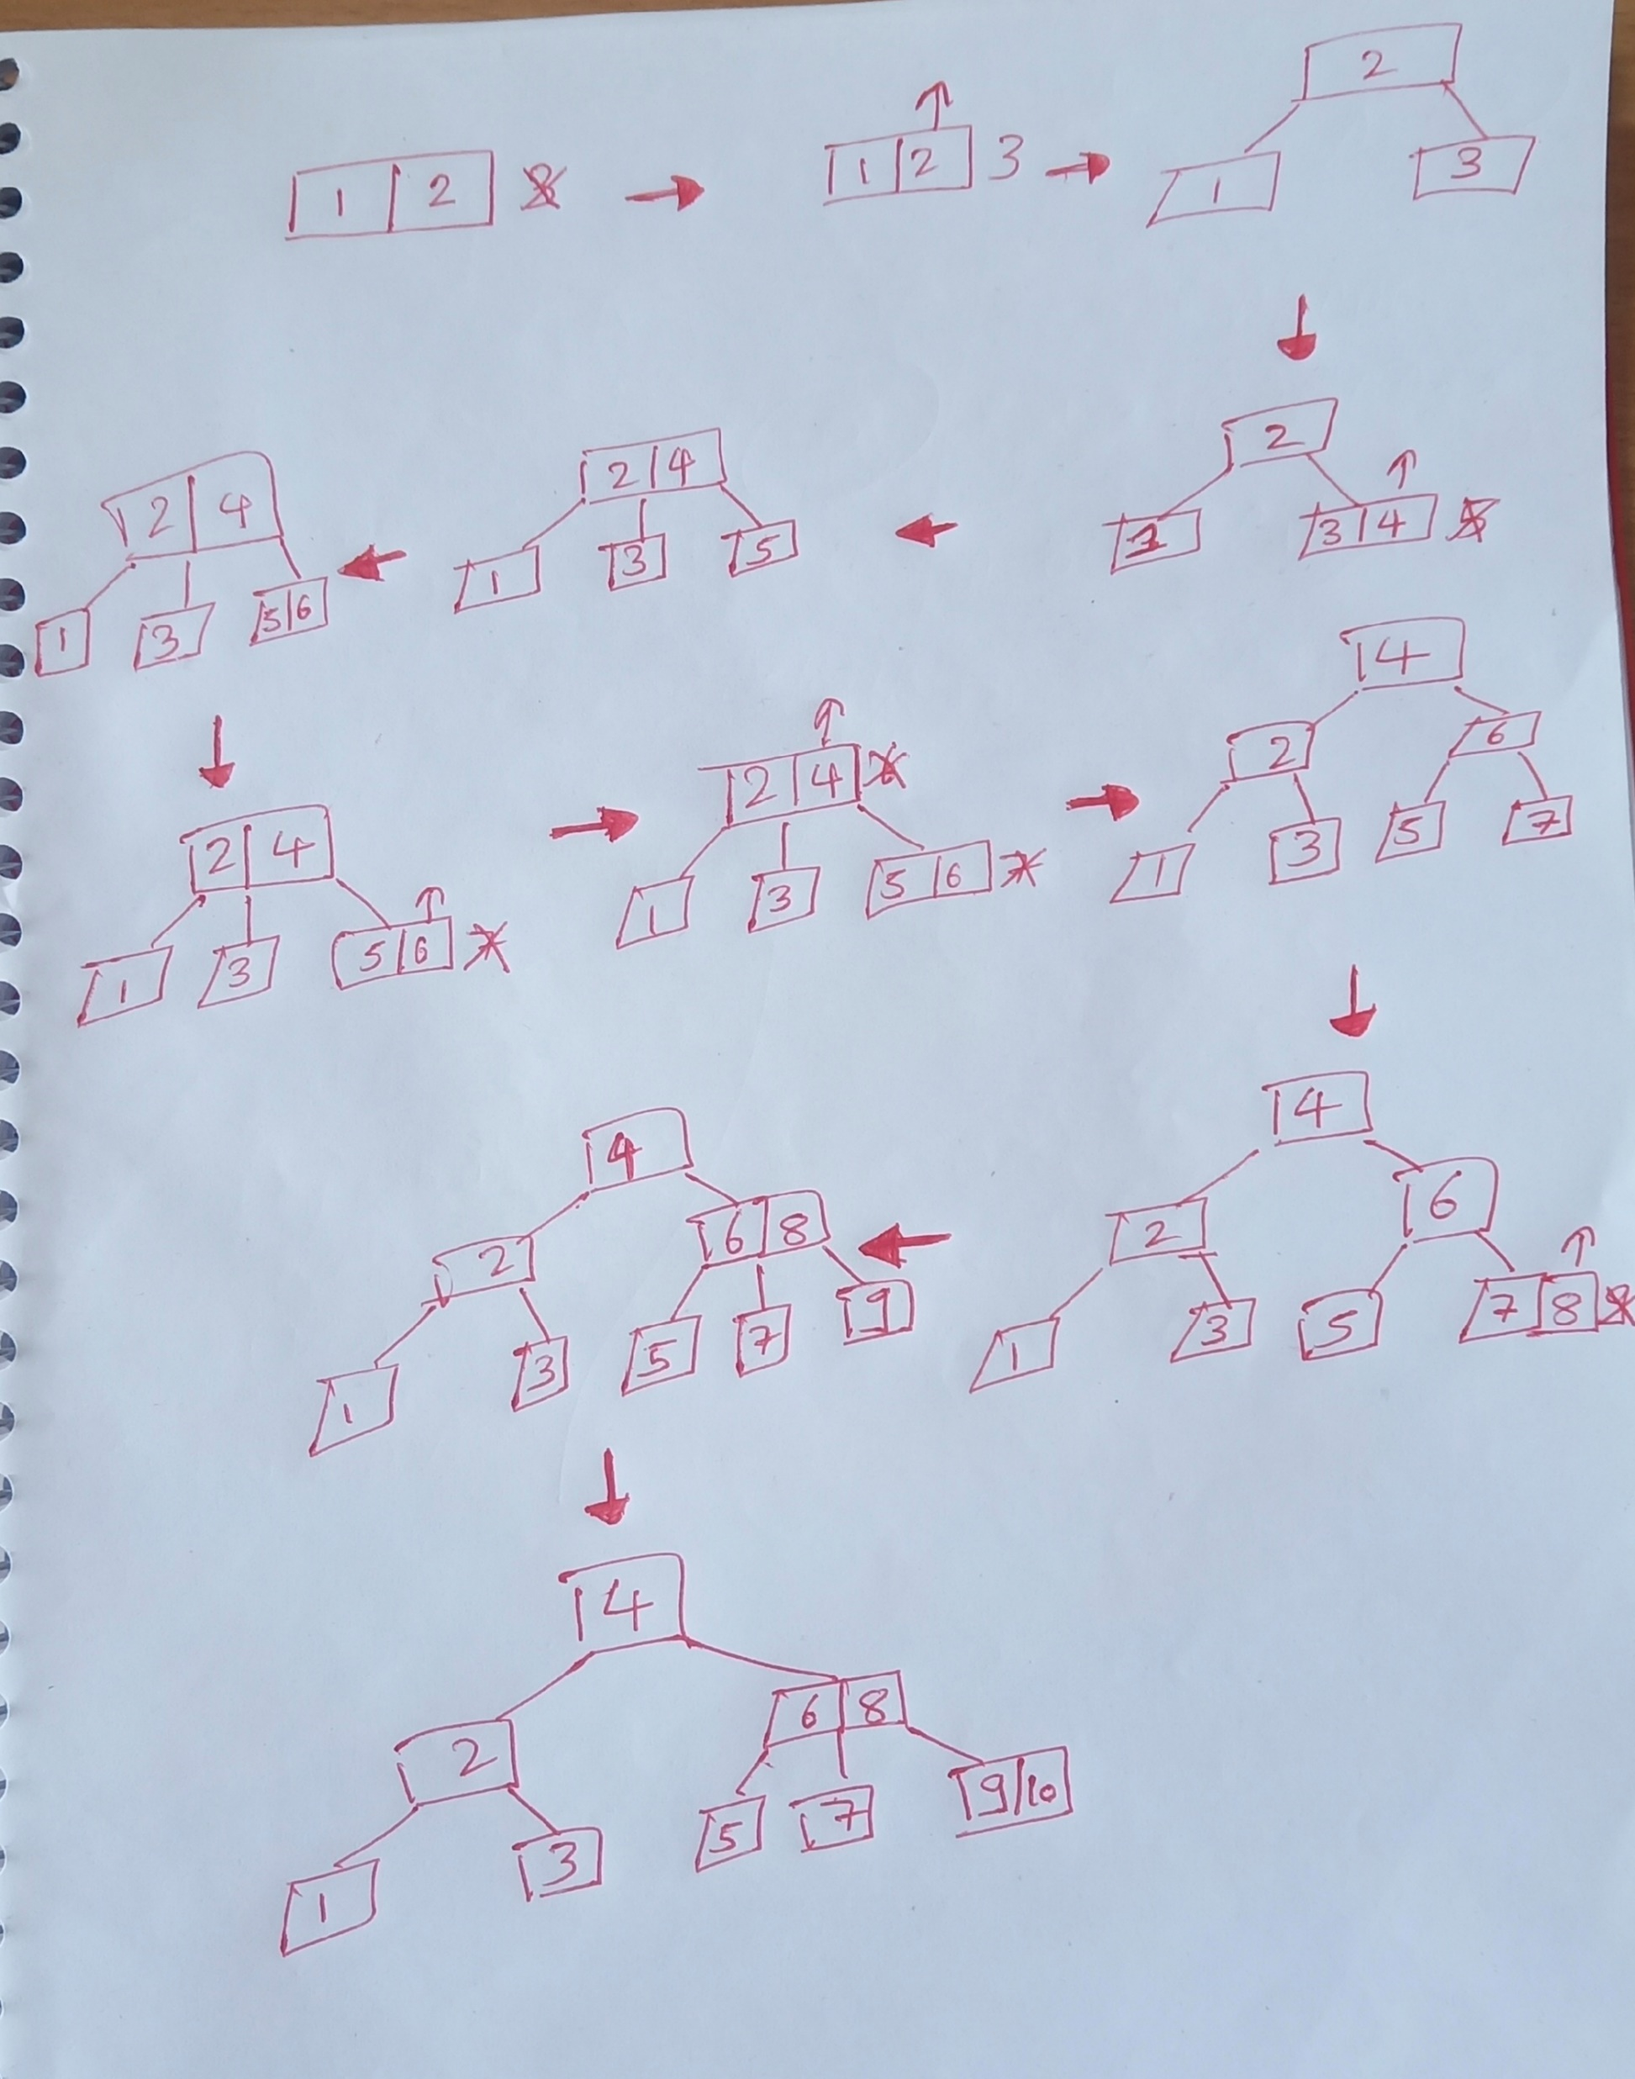
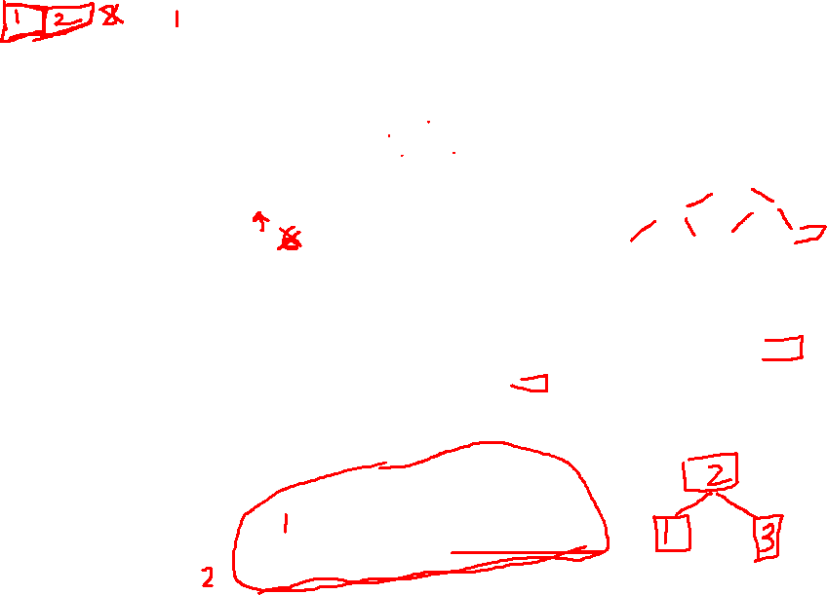

Slide 28
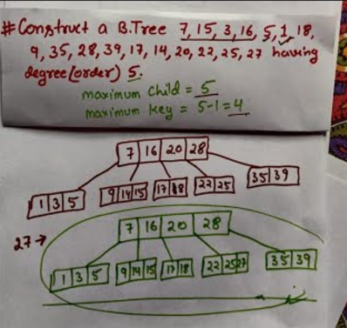

Slide 29
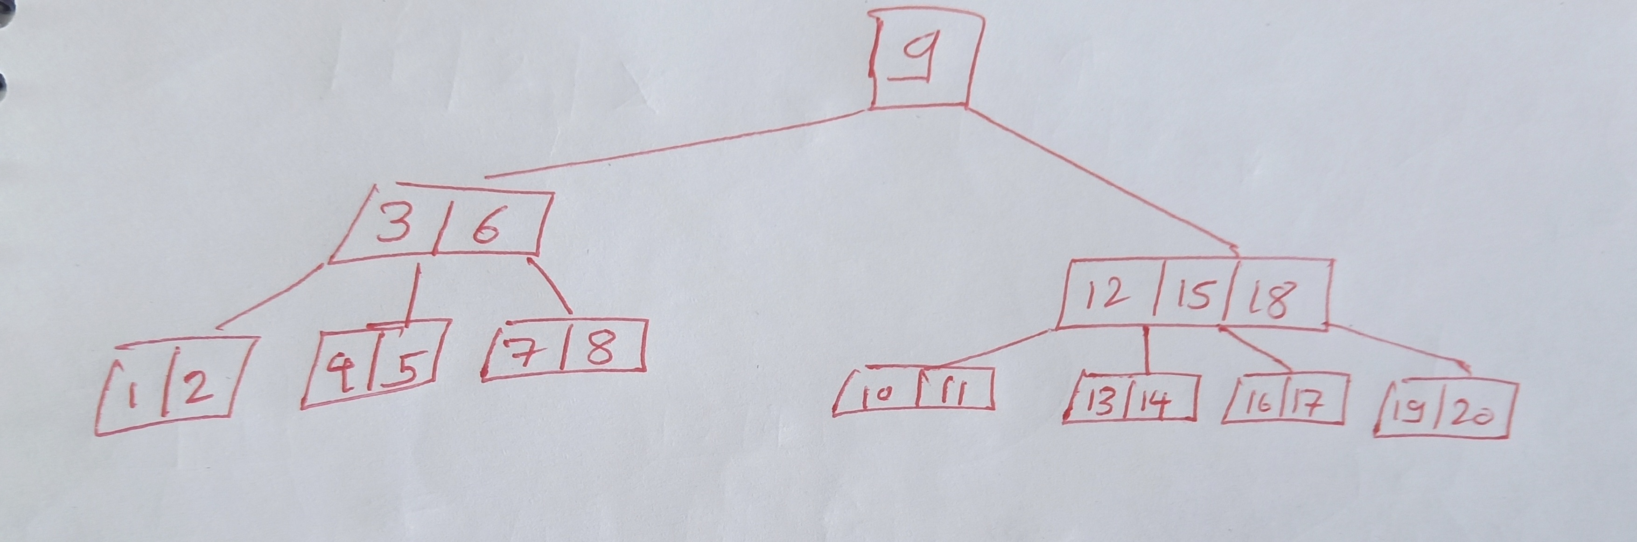
Create a B Tree of order 5 by using values from 1 to 20

